Slide 1
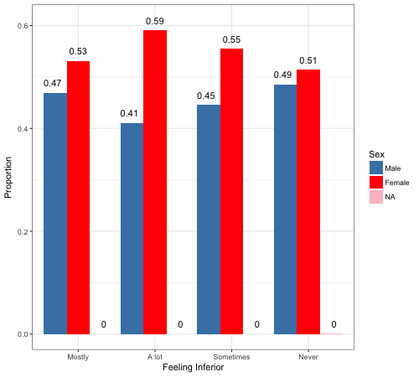
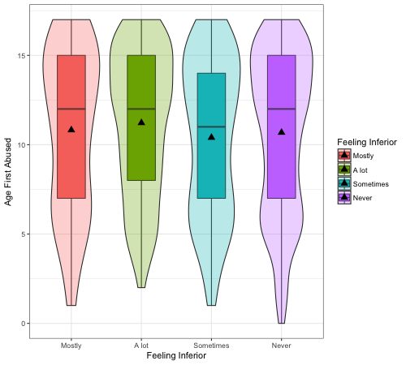
ASSOCIATION OF CHILD ABUSE & MENTAL HEALTH
Jacqueline Sanchez & Jerry Tucay
California State University, Chico
INTRODUCTION
RESULTS
CONCLUSION
It is stupefying to consider abusing a child, but according to the National Statistics on Child Abuse, over a quarter of a million children in the United states are abused every year. When these children grow to be adults, they only know of a cruel world. In the past, multiple studies have been conducted that have shown, to a significant extent, that people who have a history of being abused as a child tend to display psychological problems as an adult. We believe this research to be important because if someone is abused as a child, they may need help coping and existing in the world. So, we conduct this data collection to better understand if there is indeed a correlation between being abused as a child and having psychological issues as an adult.
In the article “Family Environment, Personality, and Psychological Symptoms in Adults SexuallyAbused as Children,” the authors found that people who had been abused as children grew up to have problems including things such as depression, low self-esteem, anxiety, PTSD, and suicidal thoughts/actions (Drerup). In many incidences, these adults have issues connecting with people, they don’t tend to agree often, and aren’t open to new things.
Rahm, Renck, and Ringsberg (2013) found poor mental health and feelings of shame in women who were abused as children, along with a high risk of developing post traumatic stress disorder. Another study conducted by Heger and team, they found that 67% of girls who were abused as children displayed symptoms of depression, which is consistent with our findings. We are interested in seeing how abuse at a young age, under 18 years old, can affect their mental health as adults. Specifically the correlation between abuse and how it makes them feel about themselves and if they develop depression.
According to the Here to Help organization, children with mental health issues are twice as likely to report being abused as their peers. Our graphical and inferential results displayed a significant relationship between those who were abused as children later on being diagnosed with depression. In fact, based on our tests, we found they are almost 2 times more likely to be diagnosed with depression than those who were not abused as children. Those abused as children were also significantly more likely to feel inferior to those around them than those who were not as abused as children. We attempted to further specify our research by testing for a relationships between the specific age at which someone was first abused as a child and whether it affected to how often they feel inferior to others around them, we failed to find a significant relationship. We did, however, find that women tend to feel inferior more frequently than men do. This seems logical due to the fact that women, statistically, are abused more than boys. Our research does not account for other factors such as counseling, that could help an abused child overcome depression.
Relationship between Gender and Feeling Inferior
Table 1. Number of males and females in each “Feeling Inferior” category
Feel Inferior | Mostly | A Lot | Sometimes | Never
Male | 116 | 338 | 729 | 1166
Female | 131 | 487 | 908 | 1233
In Fig. 1, we see that the proportion of females is greater in each category that involves feeling inferior. In the “Never” category male and female proportions are basically equal.
Figure 1. Proportion of males and females in each category of feeling inferior
Age First Abused v. Feeling Inferior
In fig. 2, we see that there is no significant relationship between the age a child is first abused and how often they feel inferior to those around them. We do notice that those abused at the youngest ages tend to be in the “Never” category. When the relationship between just being abused in general and how often one felt inferior it was found that there was a significant relationship.
IMPLICATIONS
After conducting multiple tests, we found that being abused as a child does significantly affect your chances of being diagnosed with depression later on as well as feeling inferior to those around you.
This case study only focused on two very broad types of mental health issues, to further the research we could look into other types of mental health issues, such as PTSD.
Research on how those abused as children attempted to cope may also be conducted. Did they go to counseling or did they turn to drugs and alcohol and how did it impact their mental health as adults. Counseling could have helped those abused and drugs and alcohol may have made their mental health worse or it may have helped.
QUESTIONS
Figure 2. The relationship between the age someone is first abused and how often they feel inferior
Is there a correlation between people who are physically abused before the age of 18 and having a sense of inferiority to those around them as adults?
Is there a correlation between being abused as a child and developing depression?
SAMPLE CHARACTERISTICS
Table 2. Odds Ratio for abuse and developing depression
Adults surveyed in addhealth data from all over the U.S, 3147 males and 3356 females, ranging from ages 24-32
People physically abused before the age of 18 (2897 respondents- 18.4%)
Those diagnosed with depression (2406 respondents)
Those who feel inferior to others
Column1 | OR | LCL | UCL
(Intercept) | 0.1 | 0.08 | 1.10E-01
Abused(+) | 1.94 | 1.62 | 2.32E+00
Females | 2.47 | 2.1 | 2.91E+00
REFERENCES
“Childhood Sexual Abuse: A Mental Health Issue.” Childhood Sexual Abuse: A Mental Health Issue, HereToHelp, 2015, www.heretohelp.bc.ca/factsheet/childhood-sexual-abuse-a-mental-health-issue.
Drerup Stokes, L., McCord, D., & Aydlett, L. (2013). Family Environment, Personality, and Psychological Symptoms in Adults Sexually Abused as Children. Journal Of Child Sexual Abuse, 22(6), 658-676.doi:10.1080/10538712.2013.811142
Heger, Astrid, et al. “Relationship of Child Sexual Abuse to Depression.” Child Abuse and Neglect, edited by Catherine Koverola, vol. 17, International Society for Prevention of Child Abuse and Neglect, 1992, pp. 393–400.
Rahm, G., Renck, B., & Ringsberg, K. C. (2013). Psychological distress among women who were sexually abused as children. International Journal Of Social Welfare, 22(3), 269-278. doi:10.1111/j.1468-2397.2012.00898.x
METHODS
In table 2. we see the results of an odds ratio test conducted between being abused as a child and developing depression, then further specifying the chances of developing depression if you are a female. We found that those abused as children are almost twice(1.94x) as likely to develop depression later on in life than those who were not abused as children. Females are approximately 2.5 times at higher risk of developing depression if they were abused as a child.
Respondents conducted survey at home as an in-home questionnaire
Some variables were collapsed into binary variables to compare broader questions.
Responses such as “don’t know,” “refused,” “legitimate skip,” and in some cases “this never happened to me” we omitted and classified as NA in order to get more clear results.
RStudio was used to view relationships between variables
CONTACTS
jsanchez113@mail.csuchico.edu
jtucay@mail.csuchico.edu

